Slide 1
CIS 4930-001: Introduction to Augmented and Virtual Reality
Graphics Pipeline

Slide 2
A Simplified View of the Graphics Pipeline
http://romain.vergne.free.fr/teaching/IS/SI03-pipeline.html

Slide 3
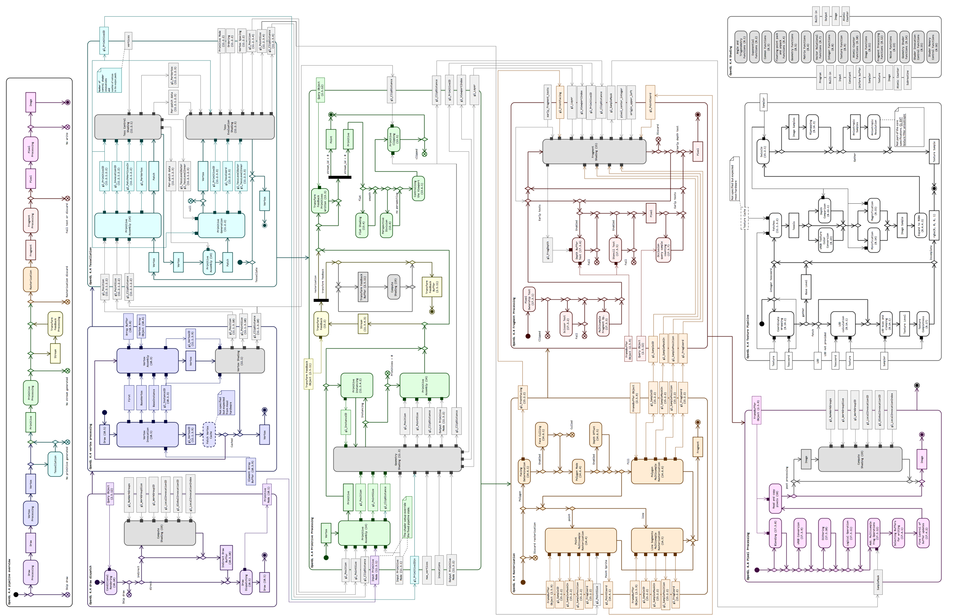
Full OpenGL 4.4 Pipeline
http://openglinsights.com/pipeline.html

Slide 4

The ”real” Virtual Reality
What does it take to create a virtual world indistinguishable from the real, in the visual sense?
80 million polygons/frame is threshold of “reality”, a sufficiently rich approximation that audiences cease to be concerned about its authenticity.
Prediction from Alvy Ray Smith, (Microsoft Graphics Guru) Co-founder of Pixar
80M ppf * 60 fps = 4.8 Gpolygons/second
Nvidia GeForce Titan RTX
Conventional: 170 Gpixels/second
Ray-tracing: 11 Brays/second
4K Resolution: 3840x2160=8.3Million pixels
So, we’re approaching/surpassing the reality threshold

Slide 5

Real time ”A Bugs Life”
1998 Pixar/Walt Disney released A Bugs Life.
Generating an average frame took 3-4 h (even up to 20h) on a 330Mhz UltraSPARC
For a minimum frame rate of 12 fps would take a speed-up of 150,000 times
Given Moore’s law, (acceleration rate of 2 times every 18 months)
would get us to year 2024.
Graphic chips have developed faster than that
Graphic chipsets doubling every 6 months
Would lead to 2007

Slide 6

Real time bugs life – Unreal Engine
https://youtu.be/qlyzo9ll9Vw

Slide 7
Real Time ”A Bugs Life”
Very unlikely trend can continue
Electron leakage and Quantum effects will appear when the electronics is shrink far enough. (Colin P. Williams et. al., Explorations in Quantum Computing)
Methods for optimizing the graphics, both in software and later in hardware helped with performance and realism leaps

Slide 8
Real Time Graphics
James Helman in “Architecture and Performance of Entertainment systems” SIGGRAPH-94 noticed that
If frame rate is lower than display refresh rate (e.g., 60Hz), motions are experienced unnatural
Ideally we would like to have frame rate == display refresh rate (generally 60Hz)

Slide 9
Frame rate - so very important for VR
Low frame rate:
Latency for the user
No presence
Uneven frame rate
Due to different object detail in the scene
Jerky graphics
Hard to interact with objects when speed in unpredictable
Constant high frame rate – What we wish for
6 fps, a sense of interactivity
15 fps is real time
30-60 minimum target for games
> 72 fps changes in display rate is undetectable

Slide 10
Why is high frame rate hard: Example
Display
1280 x 1024; 24 bit (rgb); 32 bit (depth)
30 Hz update rate
Scene
100,000 triangles
Ambient and diffuse illumination

Slide 11
Per-Frame Geometry Calculations
Geometry Traversal
300,000 vertices, normals (6 FP load/store)
100,000 start/end tokens, (2 integer load/store)
2M loads/stores per frame
Modeling transformation
300,000 vertices, normals (25 mults + 18 adds)
7.5M mults, 5.4M adds per frame
Trivial accept/reject (gross clipping)
Dot each vertex against six planes
24 mults + 18 adds per vertex: 7.4M mults, 5.4M adds per frame

Slide 12
Per-Frame Geometry Calculations
Lighting
12 mults + 5 adds per vertex: 3.6M mults, 1.5M adds per frame
Viewing transformation
8 mults + 6 adds per vertex: 2.4M mults and 1.8M adds
Clipping
Highly variable
Division by w (assuming all primitives within view frustum)
3 divs per vertex, 0.9M divides
Transform to NDC
2 mults + 2 adds per vertex: 0.6M mults, 0.6M adds

Slide 13
Per-Frame Geometry Calculations
Total for geometry:
30+ million loads & stores (depending on dataflow)
22M mults/divides + 15M adds per frame
At 30Hz frame rate, more than TWO GigaFlops!
(Not including application, system overhead, rasterization, etc.)
Modern intel chips do up to 32 flops per cycle

Slide 14
Measuring performance
Common Measurements
GFLOPS
Pixels per second (GP/s)
Texels per second (GT/s)
Memory bandwidth (GB/s)
H/W manufacturers present peak rates
Close to impossible to reach
Real world tests
Most tests are based on games: Quake, Unreal, etc…
Measures the throughput of the whole system

Slide 15
Why hardware?
Why special purpose hardware for graphics?
Even transmitting the geometry over the bus takes time
Example:
Triangle requires 36 bytes (normals, texture coords, coords)
1 Million polygons
36 Mb/s only for geometry
60 fps -> 2080 Mb/s throughput between processor and graphics hardware.
Textures can take up Giga bytes of data
Animation data etc...
We need special hardware for an efficient handling of this.
Upload geometry/textures once.

Slide 16
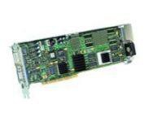
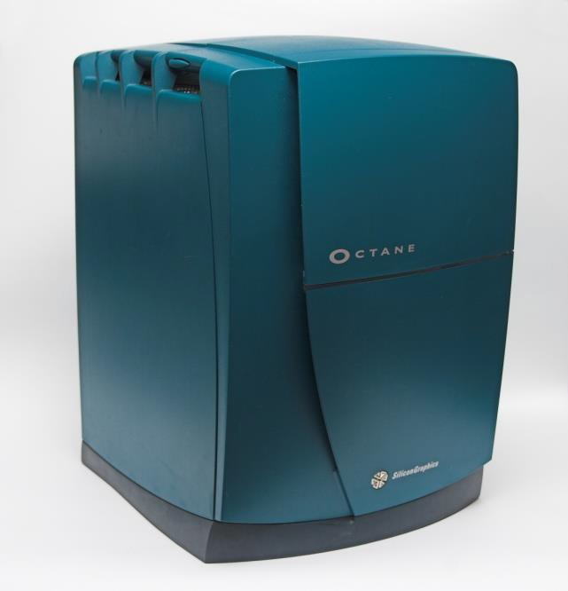
Before GPUs
Specialized solutions
Very expensive
Small market
Intergraph Wildcat 500 80Mb AGP
SGI Octane

Slide 17
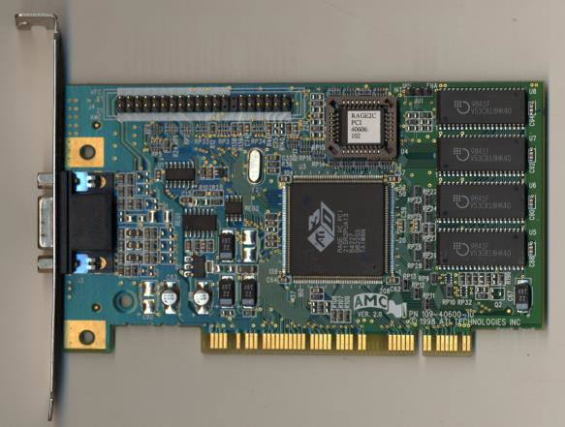
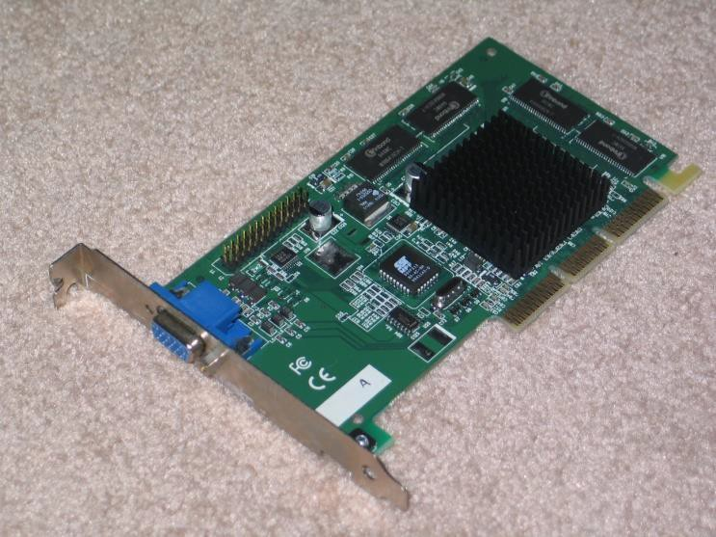
1st Generation GPUs
Fixed function only (No shaders)
Performance (TNT2)
150 MHz
230 Million pixels/second
2.4 GB/s memory bandwidth
ATI Rage2
NVIDIA TNT2

Slide 18
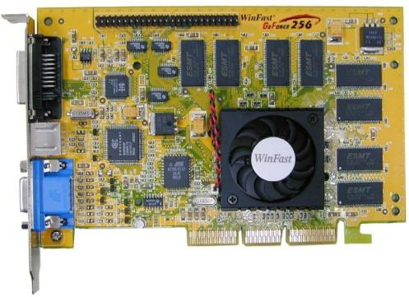
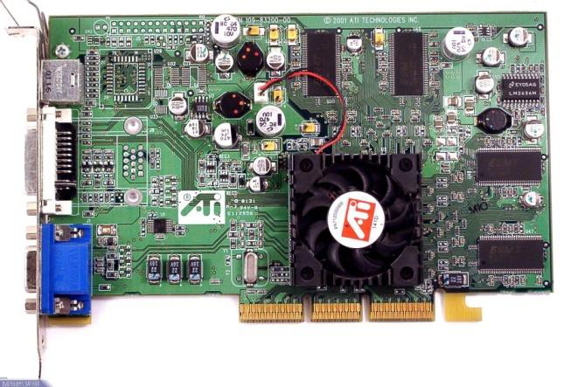
2nd Generation
First ‘GPU’* (Geforce256)
Still fixed function (no shaders)
Added H/W T&L (Transform and Lighting), cube mapping, and bump mapping
Nvidia Geforce 256
ATI Radeon 7500
* "a single-chip processor with integrated transform, lighting, triangle setup/clipping, and rendering engines that is capable of processing a minimum of 10 million polygons per second.” per NVIDIA

Slide 19
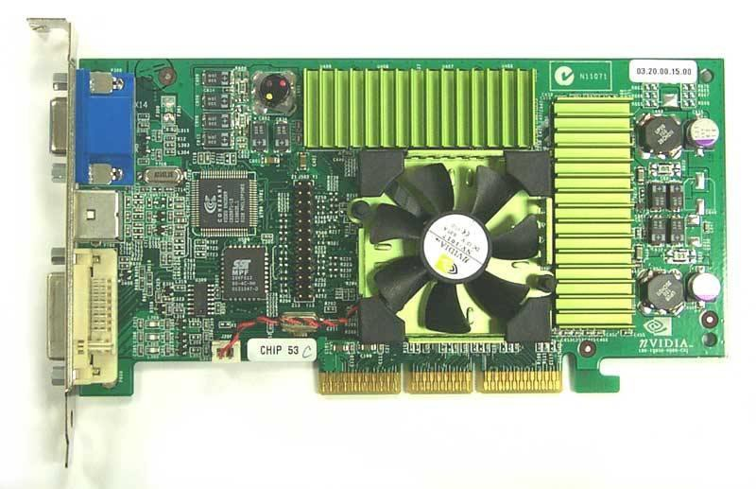
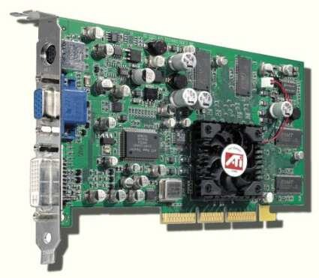
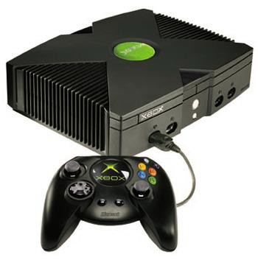
3rd Generation
Programmable Vertex shaders
No programmability for Pixel shaders
Nvidia Geforce 3
ATI Radeon 8500
XBOX

Slide 20
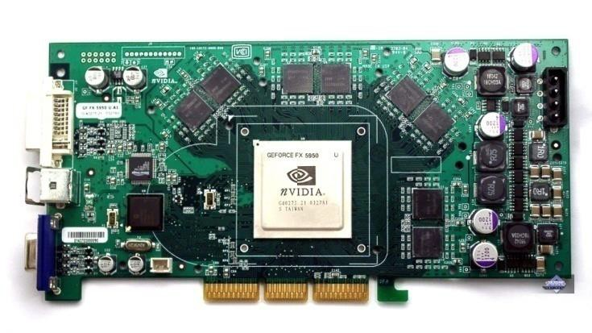
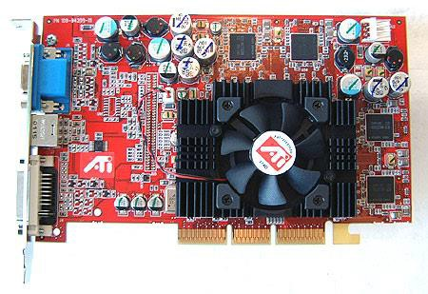
4th Generation Cards
Pixel Shaders
Loops and Branches in Vertex shaders (not in Pixel shaders)
Nvidia GeForce FX 5650
Nvidia GeForce FX 5650

Slide 21
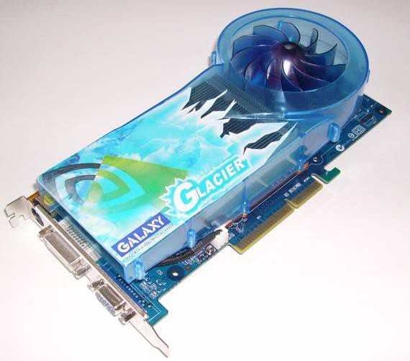
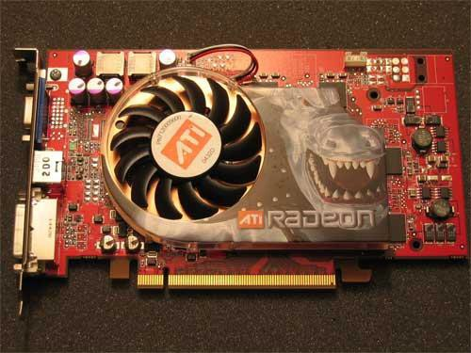
5th Generation Cards
Loops and Branches also in Pixel Shaders
Multiple Render Targets (MRT)
Nvidia GeForce 6800
ATI Radeon X800

Slide 22
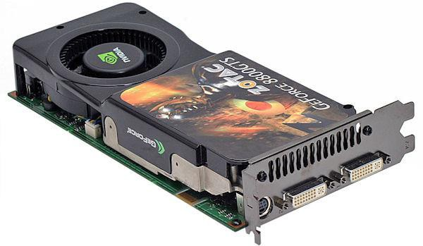
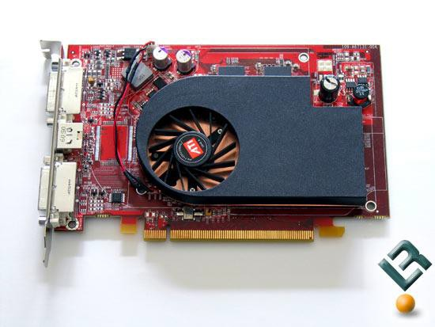
6th/7th Generation
Geometry Shaders
Tessellation Shaders
Nvidia GeForce 8800
ATI Radeon X1600

Slide 23
8th Generation
State of the Art
Real-time Ray Tracing
NVIDIA GeForce RTX 2080 Ti
AMD/ATI Radeon 5700 XT

Slide 24
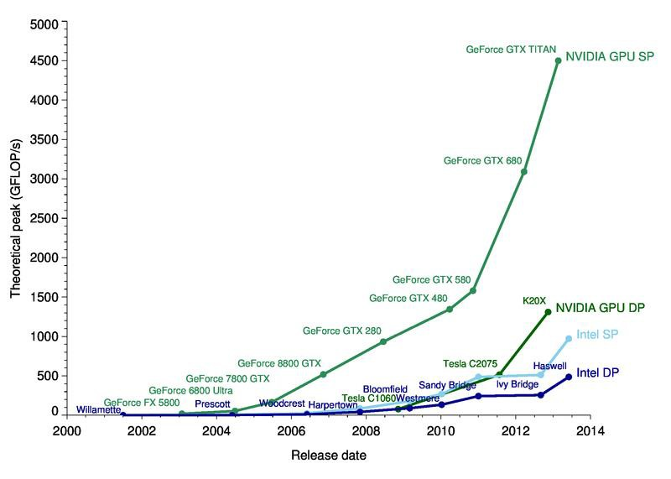
Specs – Old vs New
OLD (~2005)
Intel 3 Ghz
12 GFLOPS peak (via SSE2)
NVIDIA GeForce 6800
45 GFLOPS peak performance
More recent
Intel Core i9-7900X
10 cores @ 3.3GHz (4.3GHz max)
1.15 TFLOPS
NVIDIA GeForce RTX 2080 Ti
2944 Cores @ 1.55GHz
13.45 TFLOPS

Slide 25
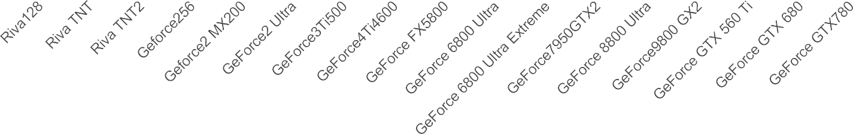
Fillrate development
Fill rate MT/S
350000
300000
250000
200000
150000
100000
50000
0
Data from wikipedia

Slide 26
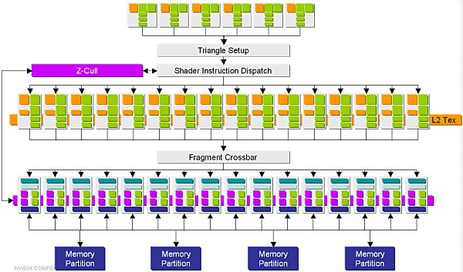
How GPUs are FAST!
What’s really important these days is parallelism, massive parallelism
Superscalar processing
NVIDIA GeForce RTX 2080 Ti – 2944 Cores

Slide 27

















Parallelization of rendering
Divide work into sub-tasks
Sorting schemas:
Sort-first
Sort-middle
Sort-last fragment
Sort-last image
A
SORT
G G G
FG
FG
FG
FM
FM
FM
A – Application
G – Geometry stage
FG – Fragment generator
FM – Fragment merging
DISPLAY

Slide 28
Sort-first
Sort primitives before geometry processing
Divide screen into tiles
Each process work on a tile in parallel, merge result
Good use for multiscreen-tiled displays
Used in SLI configurations
Disadvantage: pre-transform are required
A
SORT
G G G
FG
FG
FG
FM
FM
FM
A – Application
G – Geometry stage
FG – Fragment generator
FM – Fragment merging
DISPLAY

Slide 29

















A
Sort-middle
Geometry processors are given work arbitrary—load balancing is the goal
Each rasterizer (FG+FM) is given a tile (part of display, scanline, group of pixels etc.)
Transformed primitives is then sorted into corresponding rasterizer
Multiple rasterizers can get same primitive
G G G
SORT
FG FG
FG
FM
FM
FM
DISPLAY
A – Application
G – Geometry stage
FG – Fragment generator
FM – Fragment merging

Slide 30
A
Sort-middle (con’t)
Used in most mobile GPUs
Minimize bandwidth requirement.
Need system memory support.
High memory bandwidth usage will hammer the whole system.
Save more penguins (power).
Reducing memory access means less power consumption.
Disadvantage
One triangle may go into multiple tiles.
Need a sorting buffer after triangle sorting
More complex scene, more memory access.
Completely divide graphic pipeline into two partition.
This may harm the performance.
G G G
SORT
FG FG
FG
FM
FM
FM
DISPLAY
A – Application
G – Geometry stage
FG – Fragment generator
FM – Fragment merging

Slide 31




















Sort-last fragment
Sort fragments after FG before FM
Primitives distributed evenly over geometry units (G)
Fragment are generated, and then sorted into Fragment-merge (FM)
Imbalance can occur if a set of large triangles are sent to one FG
Used in original XBox
A
G G G
FG
FG
FG
SORT
FM
FM
FM
A – Application
G – Geometry stage
FG – Fragment generator
FM – Fragment merging
DISPLAY

Slide 32
















Sort-last image
Primitives split over separate pipelines, balancing
Complete rendering to z-depth
Final composite into image using depth.
A
G G G
FG
FG
FG
FM
FM
FM
DISPLAY
A – Application
G – Geometry stage
FG – Fragment generator
FM – Fragment merging

Slide 33
Sort-last image (con’t)
Used in most desktop GPUs
Minimize performance issue
Sorting cost is low
Desktop GPU has its own dedicated memory.
Graphics DRAM usually has high bandwidth with high latency.
Advantage
Full rendering pipeline without interrupt until per-fragment operation (compare to sort-middle)
Disadvantage
Large amount of data to be sent
Huge bandwidth requirement on frame buffer access, particularly in high resolution and anti-aliasing enable.
A
G G G
FG
FG
FG
FM
FM
FM
DISPLAY
A – Application
G – Geometry stage
FG – Fragment generator
FM – Fragment merging

Slide 34
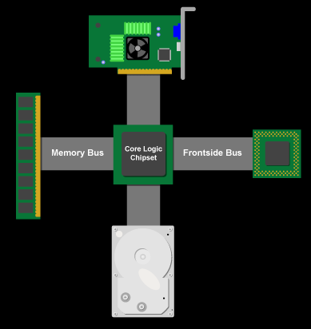
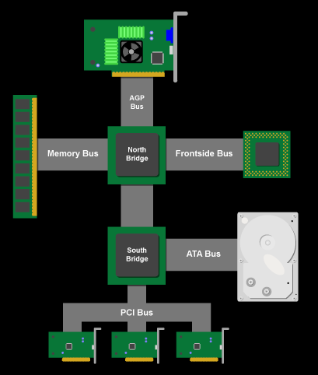
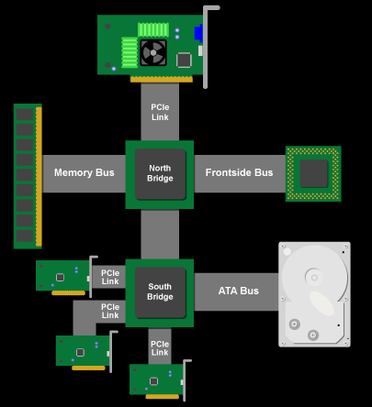
Busses: Feed the beast
PCI based—one bus shared by all traffic including GPU
AGP Based—Dedicated bus for the graphics cards
PCI express—latest generation of dedicated bus

Slide 35
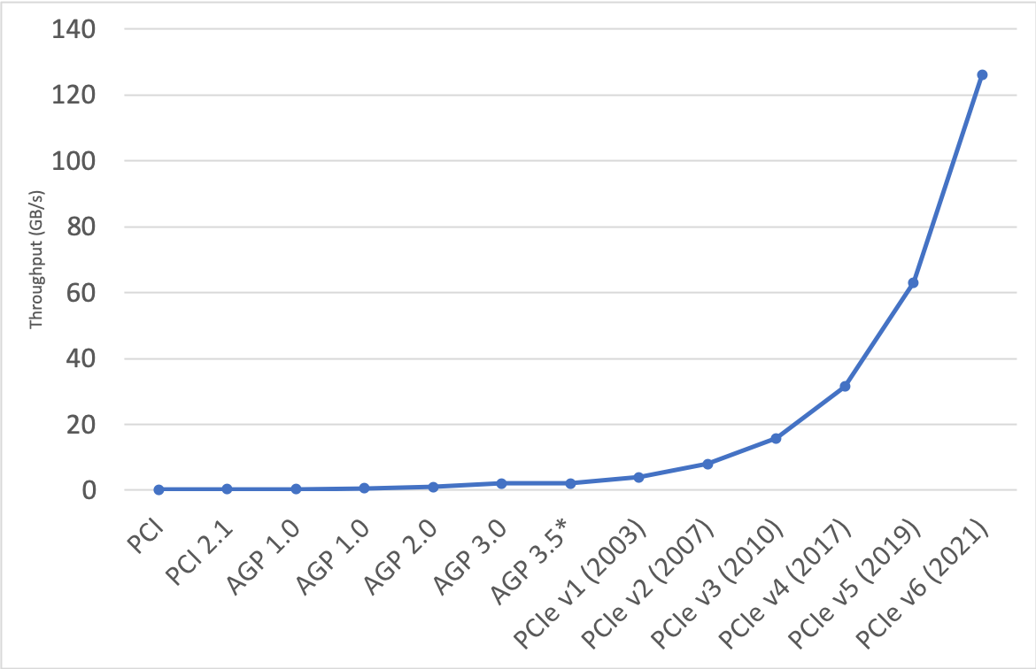
Busses
PCI, 1993
33MHz/32-bit PCI bus
The whole bus can deliver: 133MB/second
Usually peaks at: 100-110MB/sec
AGP 1.0, 1996
1x, 2x – 250MB/second; 32Bit
Runs in full memory bus speed
AGP 2.0, 1998
4x – 266.67MHz, (4 x 66 MHz), 1066MB/second
AGP 3.0, 2002
8x – 533MHz, 2.1GB/Sec
PCI-Express, 2003
16x – 4GB/sec in each direction
Doesn’t share BW with other PCI-Express slots
PCI-Express 6.0, 2021
16x – 126GB/sec

Slide 36
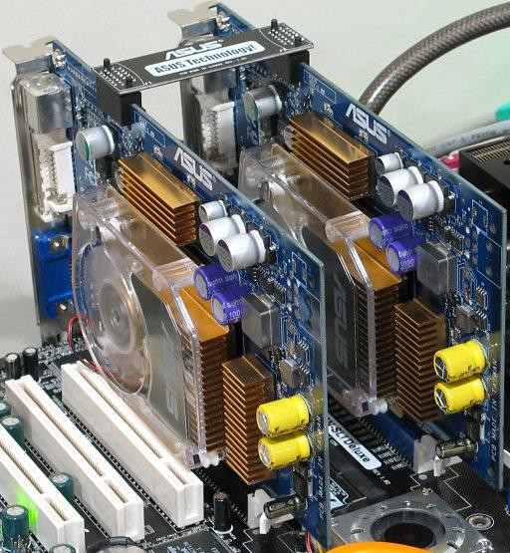
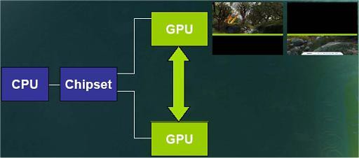
Additional busses
NVIDIA SLI
Hooking up two or more cards so that they can work in parallel.
Drivers distribute workload between the cards
For example
GPU 0 renders frame 0, 2, 4, 6…
GPU 1 renders frame 1, 3, 5, 7…

Slide 37
Know your architecture
Optimal performance is usually tied to one platform
Knowing the target platform is very important

Slide 38
The Graphics Pipeline
We could look at the 3D rendering application as a pipeline
Compare to a factory assembly
The stages operate in parallel but are stalled until all stages are done
We cannot execute faster than the slowest stage which is called the bottleneck
The rendering process is conceptually built like a pipeline

Slide 39
The Graphics Pipeline
Application
Geometry
Rasterizer

Slide 40
The Graphics Pipeline
Data will be pushed through the stages of the pipeline
The slowest stage will determine the rendering speed, expressed in frames per second.
Each stage can be further parallelized
Compare to description of NVIDIA hardware

Slide 41
Application stage
User have full control over this stage as it is executed in software
Input – User interaction, Simulations
Output – Object transform, View transform, rendering primitives
Reads input on
From devices
From the user
From the Network
The simulation that drives the application
Physics, AI, collision detection, animation
Performance affected by
Complexity of simulation, simulation size (Number of objects)
Reading from slow devices, network etc...

Slide 42








Geometry stage
Performance affected by
Number of lights, geometry complexity, shader complexity, effect complexity, etc.
Find bottleneck by using a profiler and/or disabling various components
Model & View Transform
Lightning
Projection
Clipping
Screen
Mapping

Slide 43
Rasterizer
Output
Pixels in frame buffer
Performance affected by
Size of window
Number of/size of textures
Find the bottleneck by
Increase the window size, if performance drops -> fill limited application

Slide 44
Optimization
Extreme Programming
Simple design, implement fast, test often, if need redesign, but test first!
Optimizing code is a hard task, but don’t over-optimize
Locate the major bottlenecks, remove them, move on

Slide 45
Optimizing
The bottleneck can move between the different pipeline stages.
Example, assume:
Application stage: 30ms
Geometry stage: 20ms
Rasterizer: 40ms
The maximum framerate is then 1/40ms=25Hz
Optimizing the application stage won’t improve framerate!
Although, we could use the extra time at the geometry stage (20ms idle time) for doing more complex lighting equations

Slide 46
Optimizing
Some stages are hard to test individually, as they are implemented in specialized hardware.
What we have to do is to setup a number of tests, where each test only affects one stage at a time.

Slide 47
Testing Application stage
Usually executed on CPU
If CPU ~100% we could be CPU limited
Locate the problem
Use profiling tools
CodeAnalyst (AMD)
VTune Analyzer (INTEL)
Send down data that causes the other stages to do little or no work, if CPU still 100%, the problem is in the Application stage

Slide 48
Testing geometry
Add/remove lights
Try different kinds of lights
Directional less computational intensive
Point lights
Spotlights - most demanding
If performance changes, we are transform-limited
If we are using programmable shaders, we can remove the lighting equation, to see if performance increases.

Slide 49
Testing Rasterizer
Size of rendered surface
Turn off blending and depth buffering

Slide 50
Overall optimization
Reduce the number of primitives
Culling (later on)
Reduce the complexity of the models
Level of detail—render object only as accurate as necessary
Choose as low a precision as is possible
Vertices, normals, texture coordinates (watch out for anomalies!)
Turn of features not used
Fog, blending, lighting, transparency etc..
Preprocess the models
Most hw prefers triangles and quads, not polygons (>4 corners)
Tri-strips reduces data sent over the bus

